Slide 1
Unequal Force:
Analyzing Police Killings Across America
The Data Vizards
Ankita Mishra
Kavana Manvi Krishnamurthy
Sanchal Sunil Dhurve
Jonathan Lindahl

Slide 2
STORY
The Initial Shock: Race & Police Killings Focuses on racial disparities in police killings, analyzing trends over time, causes of death, and per capita rates by comparing racial groups to population data.
Armed vs. Unarmed Disparities Unarmed individuals, particularly from marginalized racial groups, face a significant risk of fatal police encounters, highlighting disparities in the perceived threat and response.
The Geography of Risk Explores location-based differences, including regions and high-risk community profiles.
When Factors Collide: The Intersectionality Analysis Investigates how intersecting factors like race, income, gender, age, and geography create compounded vulnerabilities, and explores whether being armed or the cause of death adds to the risk.

Slide 3
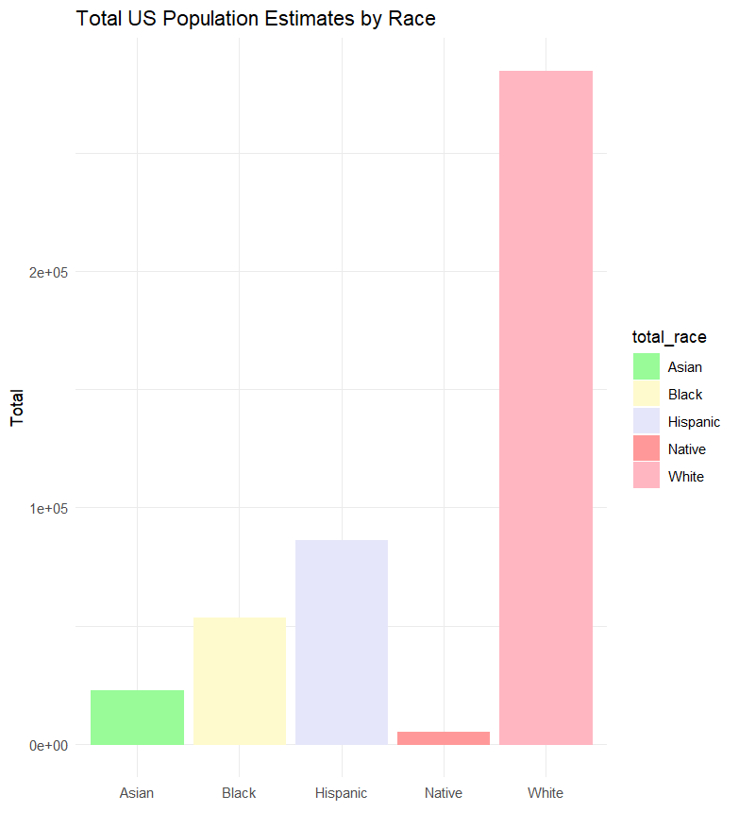
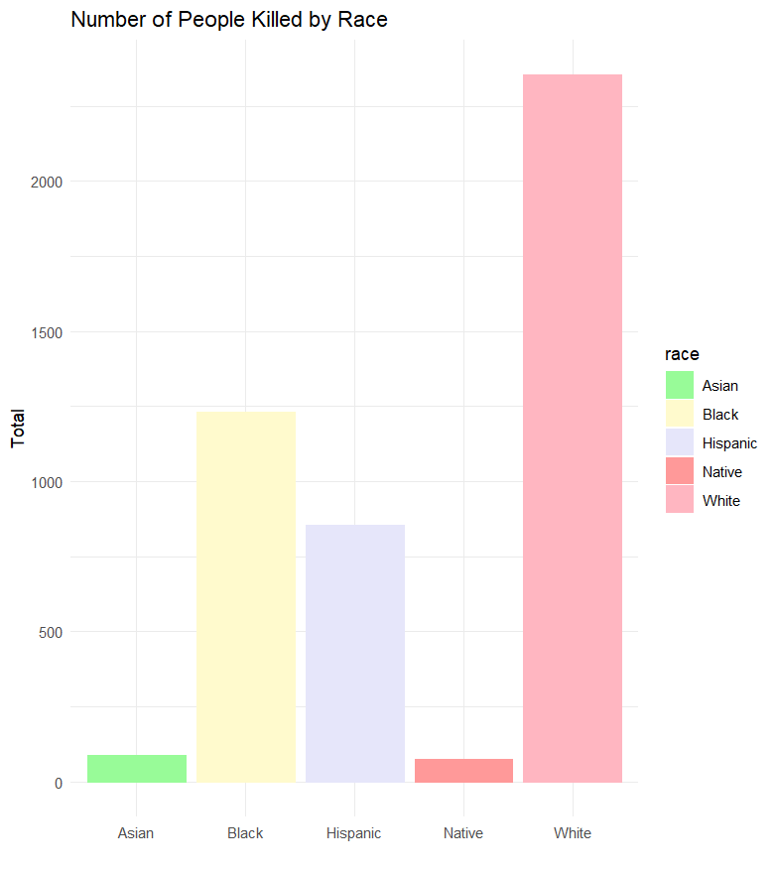
The Initial Shock: Race & Police Killings

Slide 4
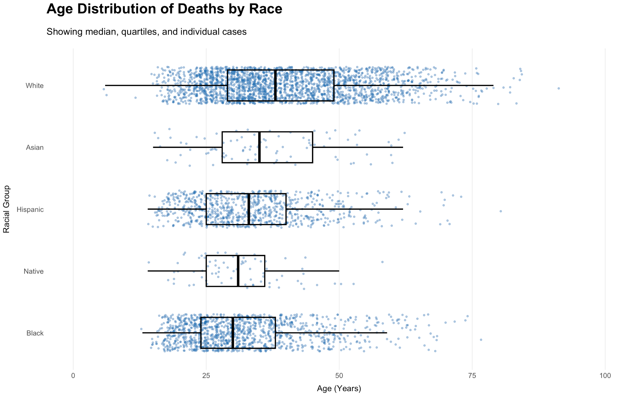
The Initial Shock: Race & Police Killings
Younger Median Age at Death for Black Individuals: Black individuals experience a significantly lower median age at death compared to White individuals, indicating that younger Black people are disproportionately affected in police-related deaths.
Concerning Trend Among Black and Hispanic Populations: The skew toward younger ages in police-related deaths for Black and Hispanic individuals highlights a troubling trend, with these populations being impacted more frequently at younger age.

Slide 5
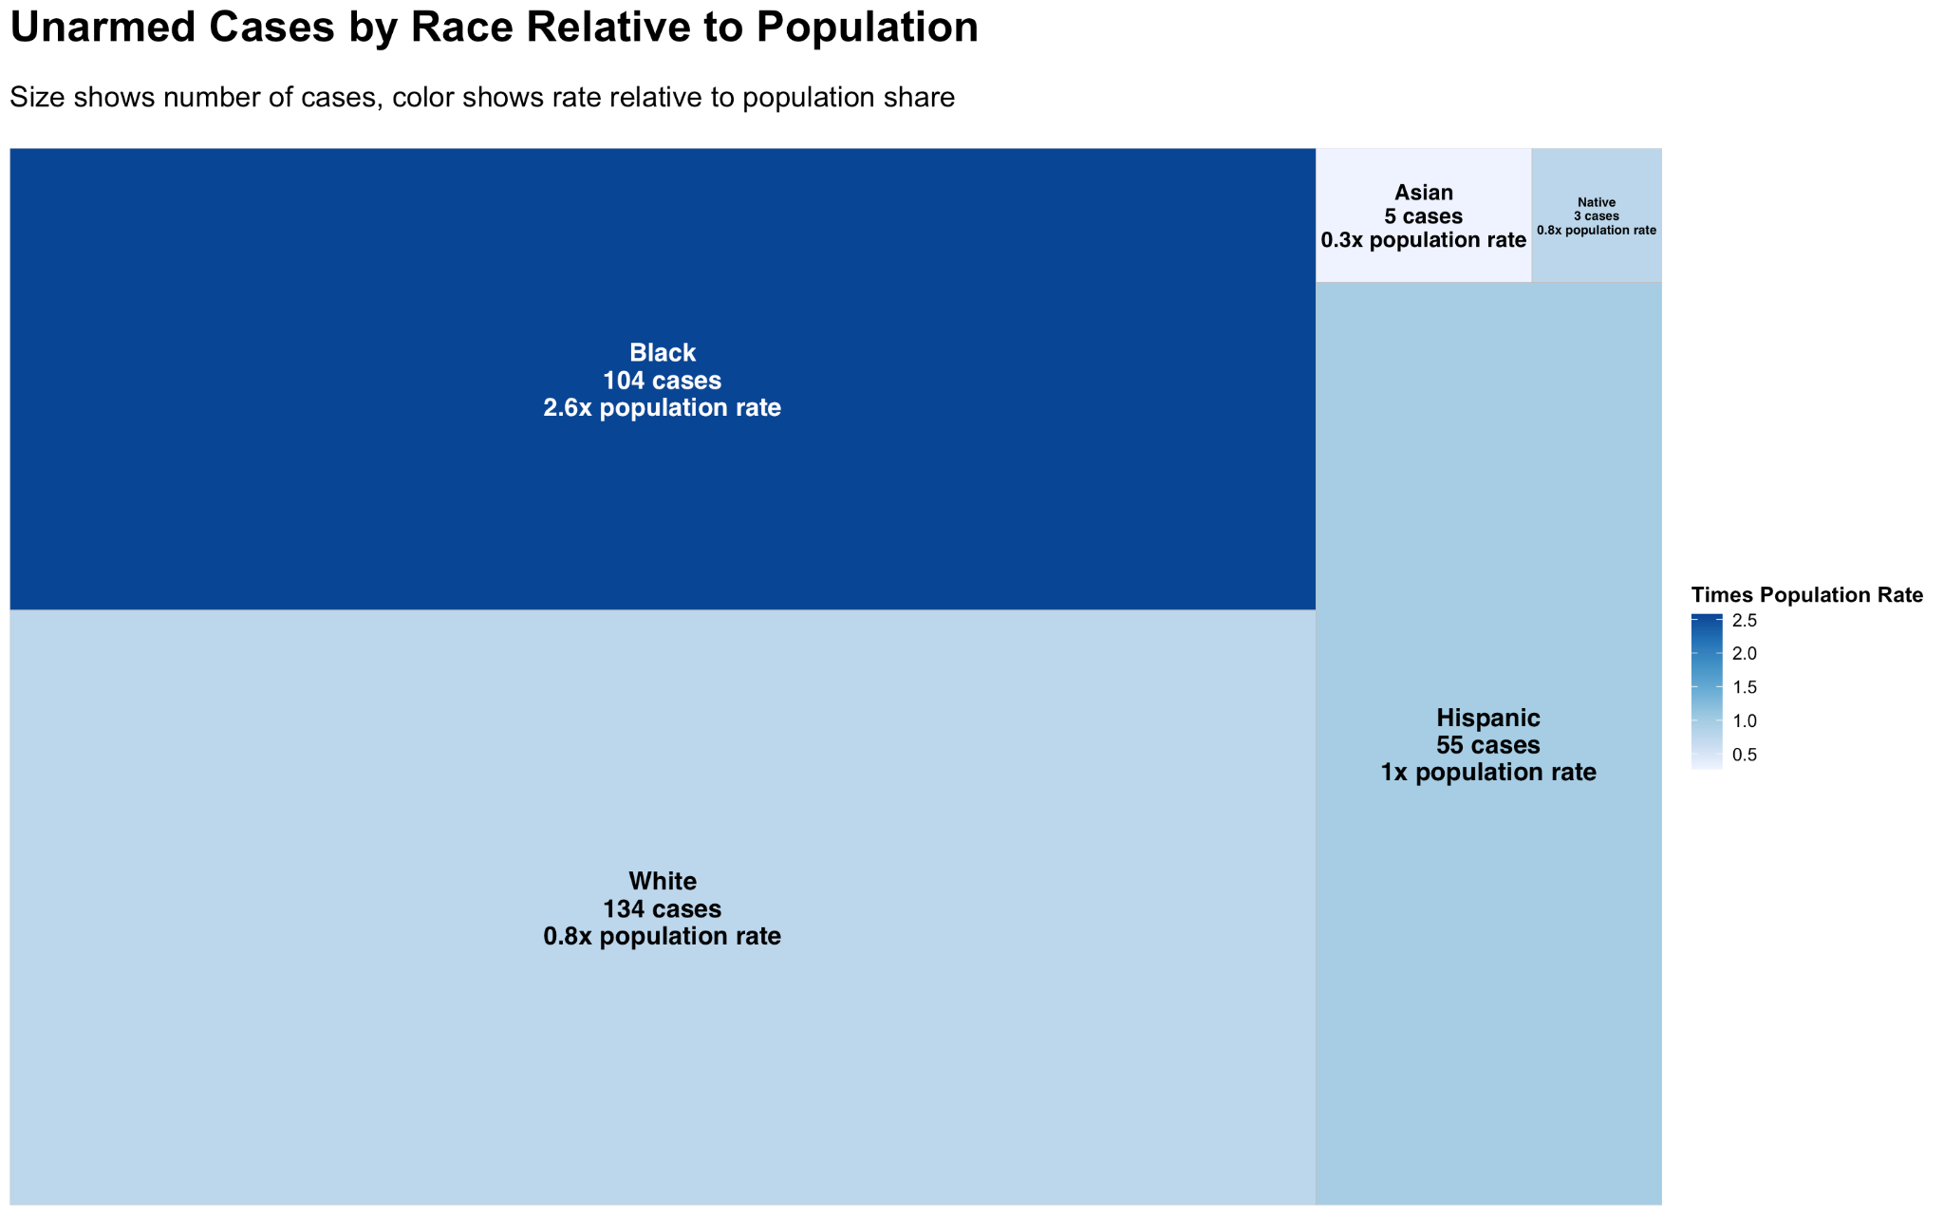
Armed vs. Unarmed Disparities
Black individuals are killed by police while unarmed at 2.6 times their population rate.
Other groups (White, Asian, Native) had rates lower than 1 relative to population
Suggests potential bias in handling unarmed encounters across races.

Slide 6
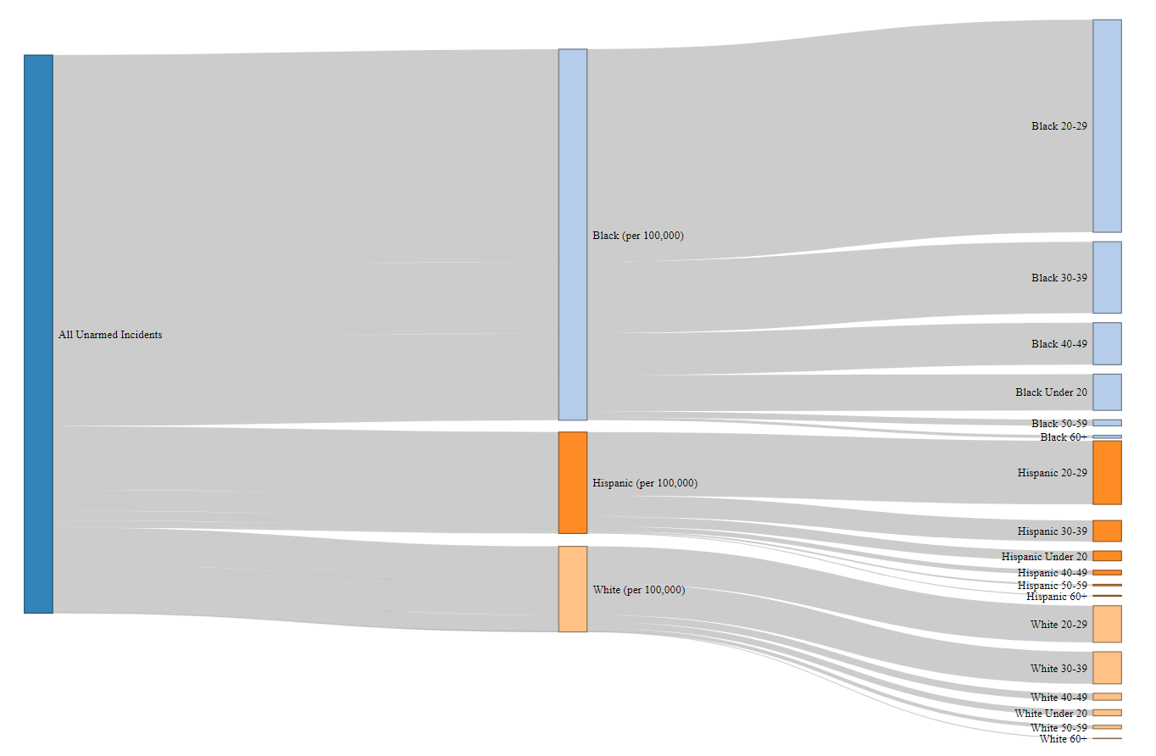

Slide 7
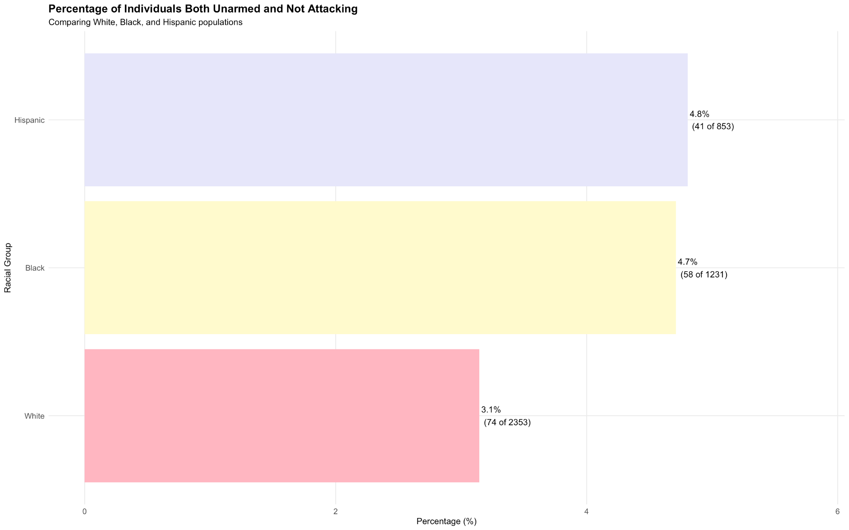
Hispanic, Black, and White populations were analyzed as they had enough data to meet these conditions.
Among unarmed, non-attacking cases:
4.8% of Hispanic individuals met these conditions.
4.7% of Black individuals met these conditions.
3.1% of White individuals met these conditions.
Hispanic and Black individuals are 1.5 times more likely than White individuals to be killed while posing no apparent threat.
Notes:
After this we looked closer at unarmed and not attacking individuals by race. We focus on just Hispanic, Black, and White populations as they were the only ones with sufficient number of data points to meet both of these conditions.

Slide 8
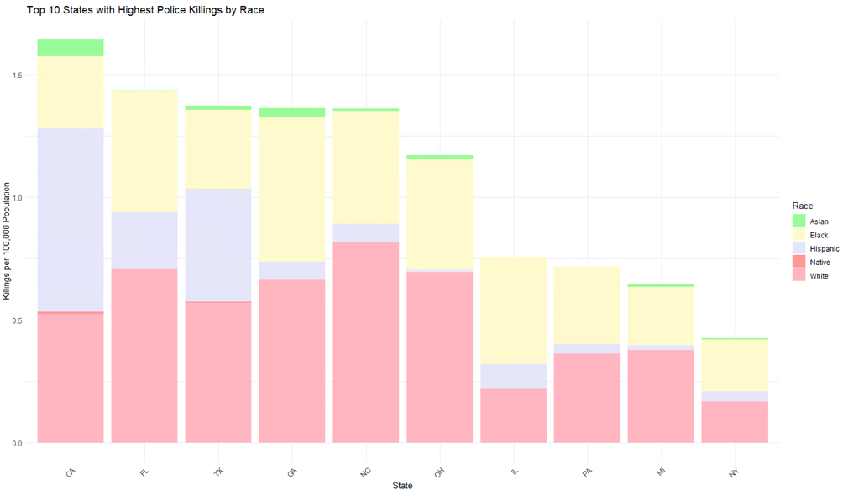
The Geography of Risk
Top States: California, Florida, and Texas have the highest police killings per 100,000 people.
Most Affected: White, Black and Hispanic populations see the largest impacts in these states.
Racial Disparities: Black populations consistently face higher rates, reflecting systemic patterns in police violence.

Slide 9
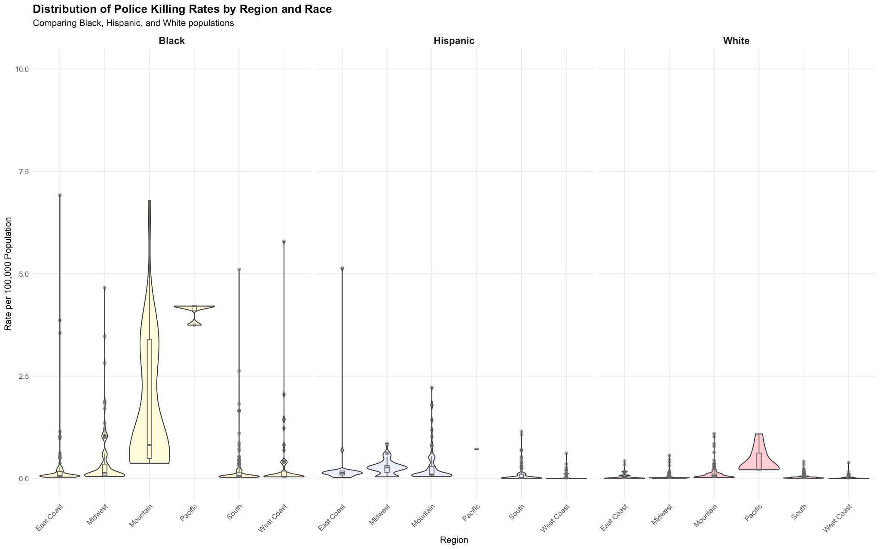
We focused on White, Black, and Hispanic groups due to higher rates of police killings.
Black Populations: Highest rates in the Mountain region, with a significant outlier showing increased risk.
Hispanic Populations: Highest rates on the East Coast, reflecting risks in areas with large Hispanic populations.
White Populations: Highest rates in the Pacific region, with less variability than other groups..

Slide 10
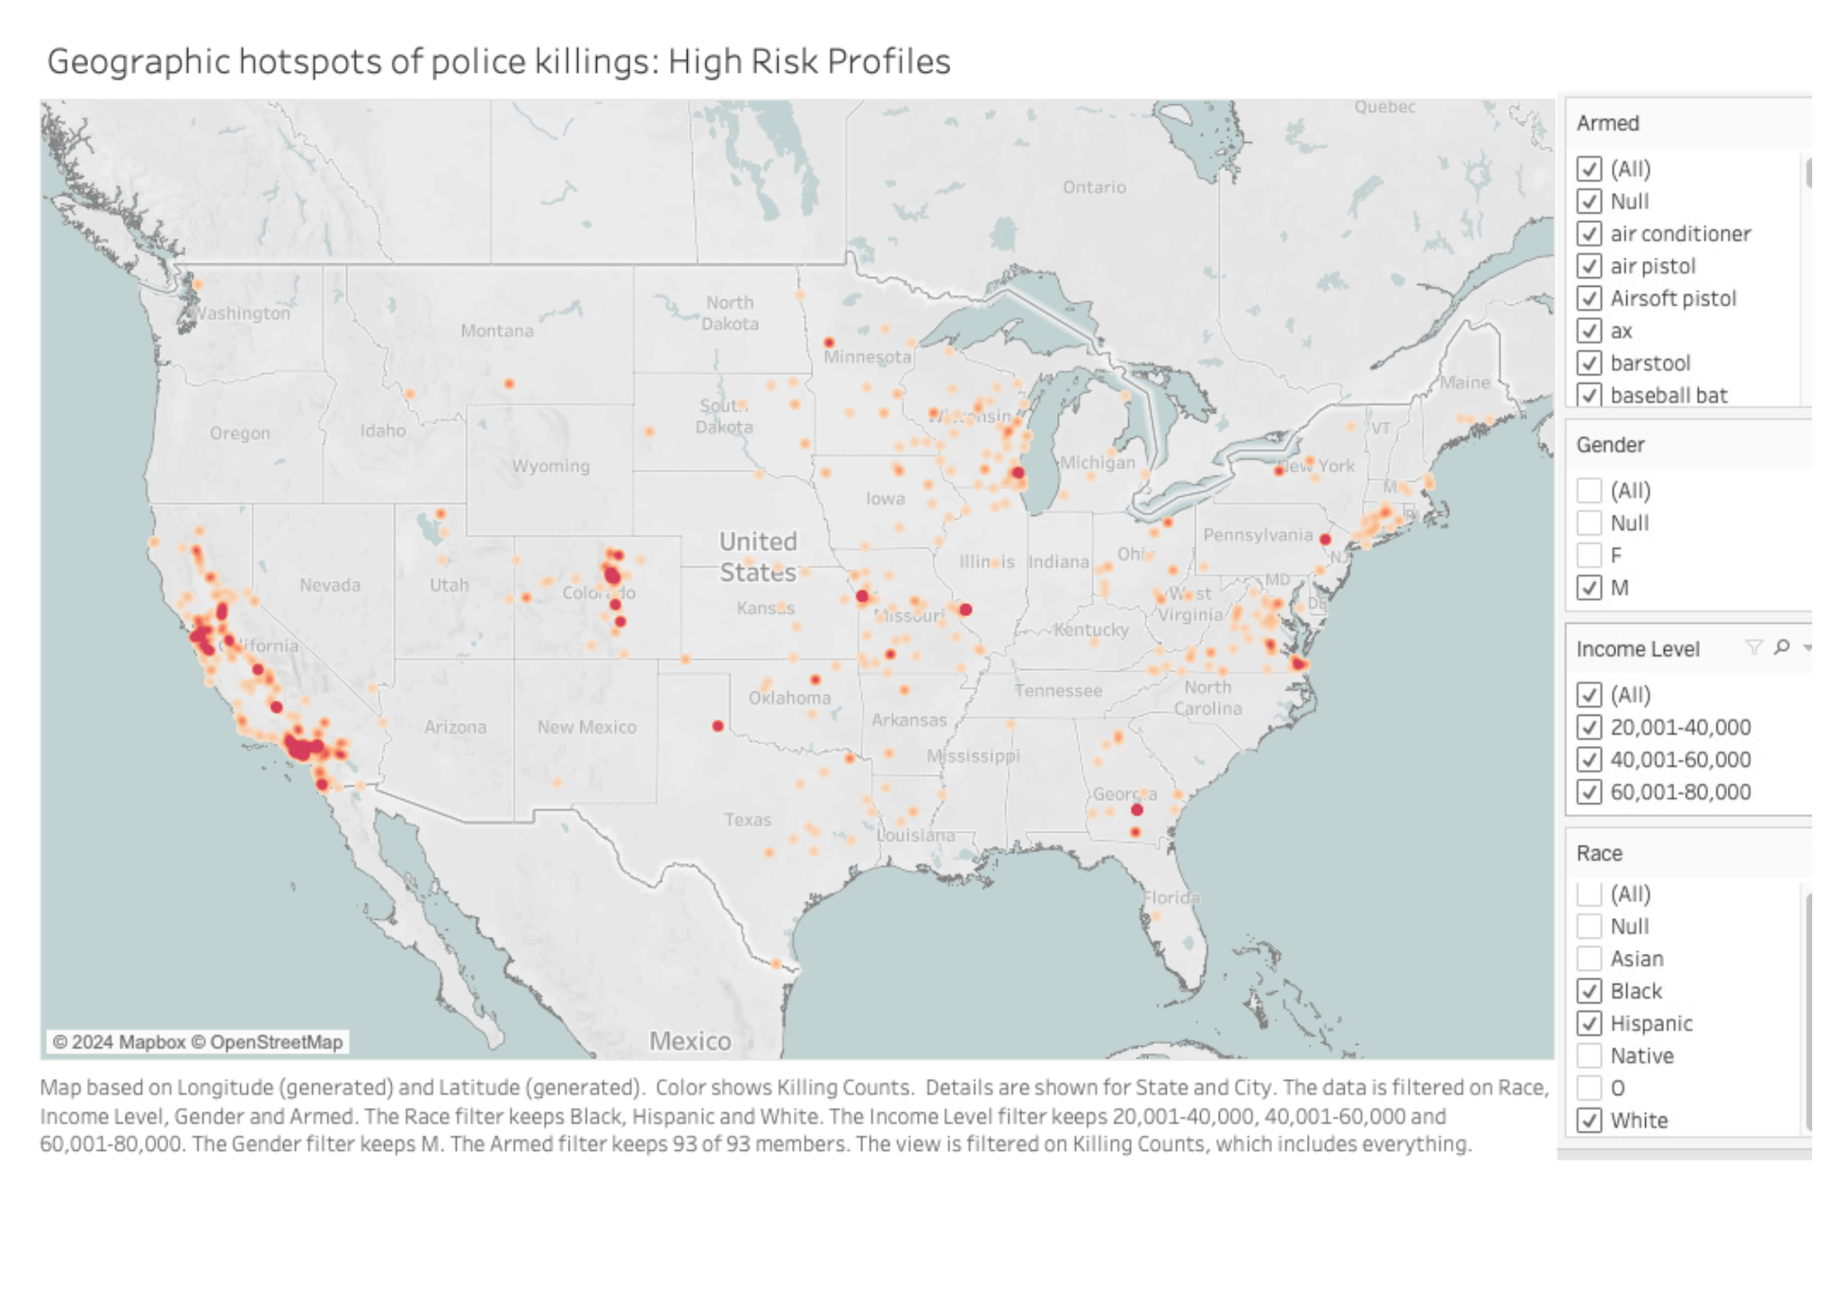
Visualizing High-Risk Profiles: A choropleth map highlights police killings across top high-risk groups (e.g., Black, Hispanic, White males) and lower income levels, with color intensity showing the frequency of killings.
Interactive Analysis: The map’s filters (e.g., race, gender, income) allow users to explore how risk varies across geographic regions.
Compounded Risk Factors: Geographic layers reveal compounded vulnerabilities, showing how race, gender, and socioeconomic status heighten risk in certain states and cities.
Policy Implications: Insights can guide resource allocation, training, and community policies, helping target interventions where they’re most needed.

Slide 11
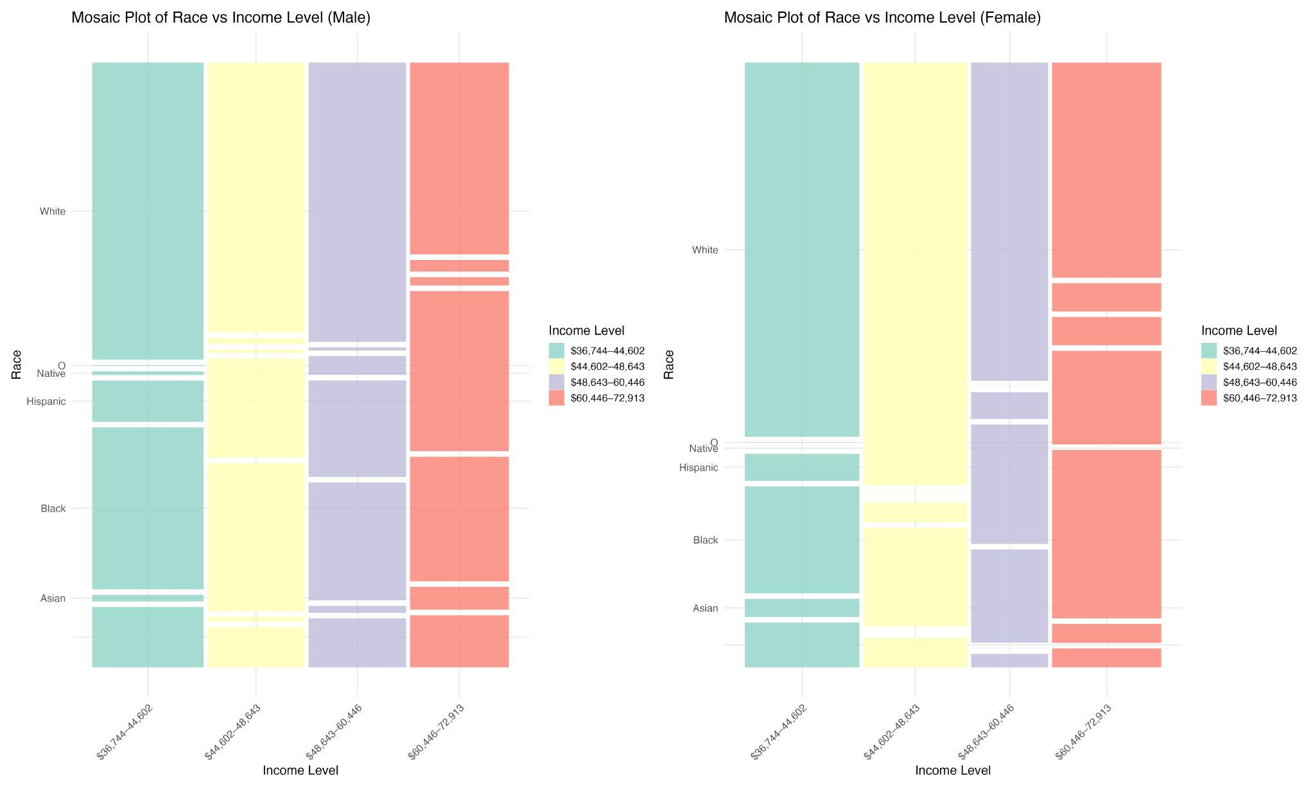
When Factors Collide: The Intersectionality Analysis
Disproportionate Impact on Black Men: Black men are overrepresented in police killings across all income levels, highlighting systemic biases.
Income and Race Link: The highest percentage of Black men killed by police falls within the lowest income bracket, showing a socioeconomic dimension.
Gender and Racial Gap: Black men are far more likely to be killed by police than Black women, and while White men have a higher total number, Black men are disproportionately affected.
Contributing Factors: Implicit bias, socioeconomic challenges, and over-policing in minority communities may contribute to these disparities.
Notes:
]

Slide 12
CONCLUSION
Key Takeaway: Police killings reveal significant disparities across racial, socioeconomic, and geographic dimensions, underlying systemic inequalities that impact vulnerable communities.
The Role of Intersectionality: The compounded risks faced by individuals at the intersection of race, low income, and other demographic factors highlight the need for a more nuanced understanding of these inequalities.
Call for Action: Addressing these disparities requires comprehensive policy reform, focusing on equity, accountability, and bias reduction in law enforcement practices.
Future Implications: Continued research and advocacy are crucial for promoting justice and creating safer environments for all, irrespective of race, socioeconomic status, or other intersecting factors.

